Slide 1

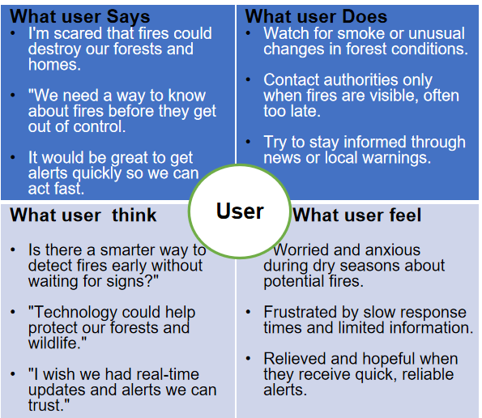
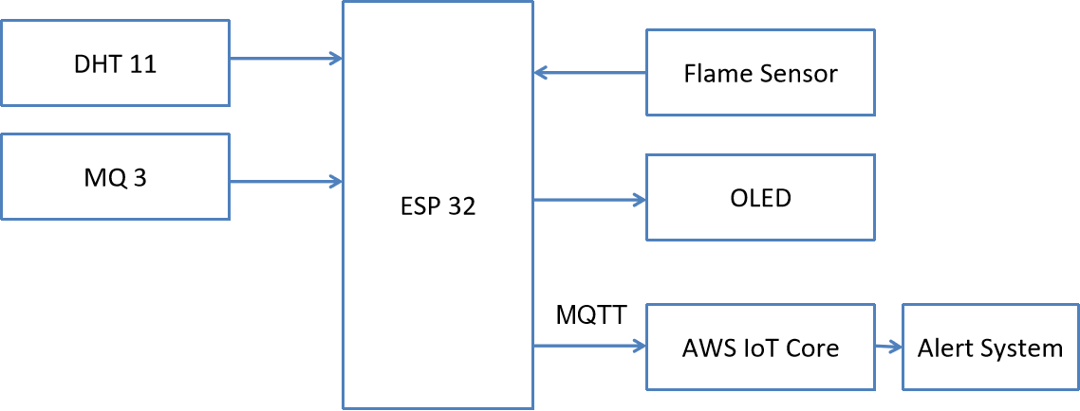
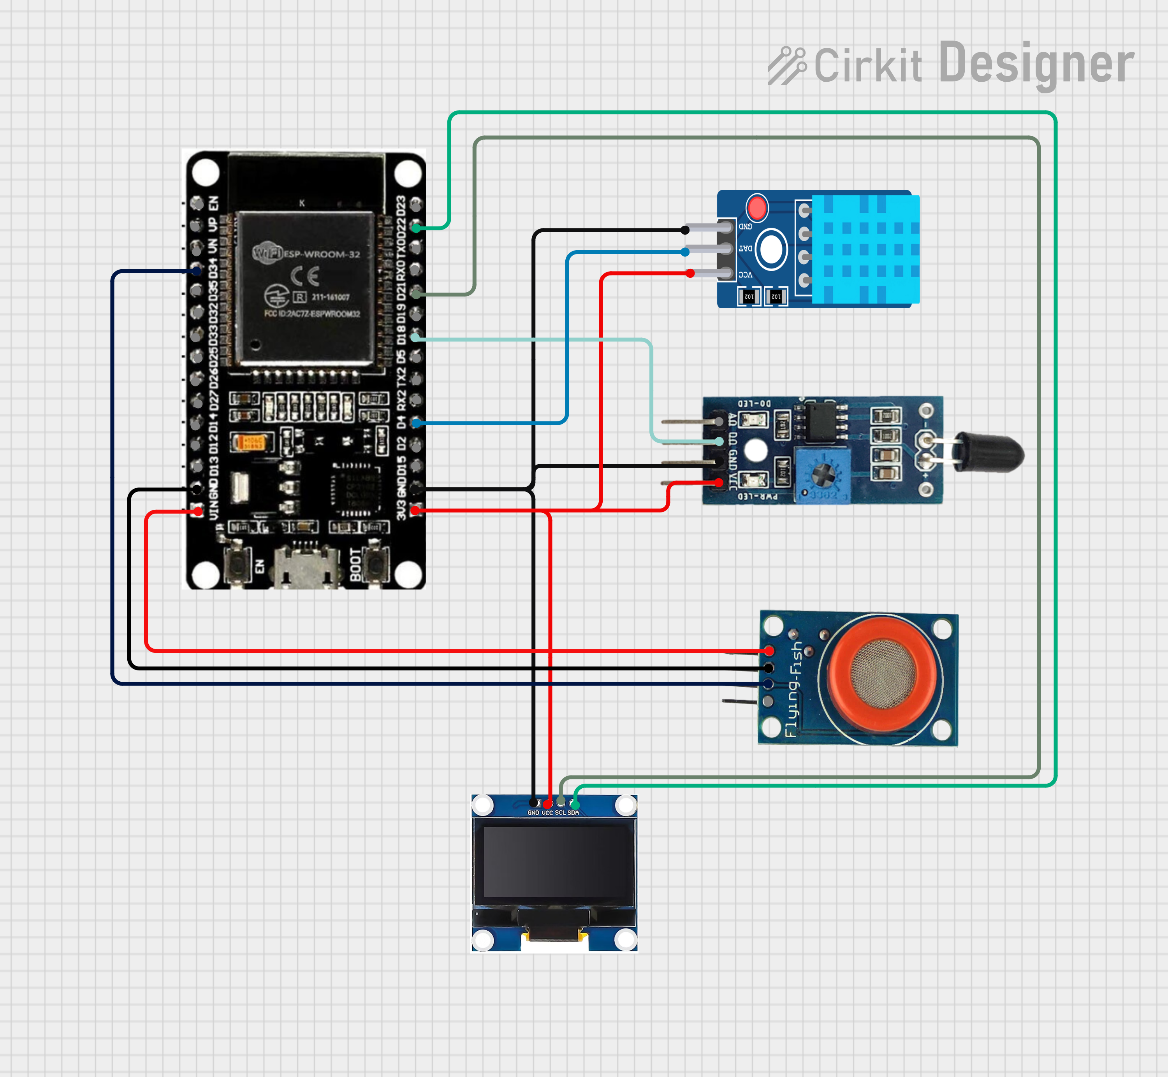
MIT SCHOOL OF COMPUTING
Class : TY ECE
Group ID :MAI252610
DEPARTMENT OF COMPUTER SCIENCE & ENGINEERING
AIEC - MDM – IoT Applications with Raspberry Pi and Sensors (23CSE2712) SEM-V 2025-26
The Forest Fire Early Warning System using AWS
Snehal Sukashe(ADT23SESB0226), Prajwal Bahir(ADT23SESB0215) ,
Rohit Darode(ADT23SESB0235) , Akash Deshmukhe(ADT23SESB0202)
Faculty Guide:
Prof. Dr. Megha.M.Wankhade
Prof Dr .Pranav.P.Chippalkatti
Sr. No. | Requirement | Proposed Solution
1 | Sensors | Use multiple sensors (temperature, smoke, flame, ) to collect real-time forest data.
2 | Data Transmission | Send sensor data wirelessly from Arduino Mega WiFi to AWS IoT Core using MQTT protocol.
3 | Alerts | Send instant alerts via SNS and display local warnings on OLED screens for quick action.
Problem statement
Forest fires endanger wildlife, forests, and communities, yet existing detection methods remain slow and unreliable. A real-time, intelligent early warning system is essential to reduce risks and prevent large-scale damage
Proposed Solution
The system uses an ESP32 microcontroller integrated with flame, MQ3 gas, and DHT11 sensors to monitor environmental conditions. Sensor data is processed and transmitted securely to AWS IoT Core, where it triggers alerts via AWS SNS for immediate response. An OLED display shows real-time readings, providing both local and cloud-based monitoring.
Scope and Feasibility
The project aims to develop a smart Forest Fire Early Warning System using ESP32, DHT11, MQ3, and Flame sensors integrated with AWS IoT Core. It monitors temperature, humidity, smoke, and flame levels, sending real-time alerts through AWS SNS. The system is cost-effective, easy to implement, and scalable for large forest areas, making it a reliable solution for early fire detection and environmental safety.

Slide 2
What user Says I'm scared that fires could destroy our forests and homes. "We need a way to know about fires before they get out of control. It would be great to get alerts quickly so we can act fast. | What user Does Watch for smoke or unusual changes in forest conditions. Contact authorities only when fires are visible, often too late. Try to stay informed through news or local warnings.
What user think Is there a smarter way to detect fires early without waiting for signs?" "Technology could help protect our forests and wildlife." "I wish we had real-time updates and alerts we can trust." | What user feel Worried and anxious during dry seasons about potential fires. Frustrated by slow response times and limited information. Relieved and hopeful when they receive quick, reliable alerts.
User

Slide 3
Sr. No. | Requirement | Proposed Solution
1 | Sensors | Use multiple sensors (temperature, smoke, flame, GPS) to collect real-time forest data.
2 | Data Transmission | Send sensor data wirelessly from Arduino Mega WiFi to AWS IoT Core using MQTT protocol.
3 | AI Analysis | Use AI models on AWS to analyze data and detect early signs of forest fires automatically.
4 | Alerts | Send instant alerts via SMS or app and display local warnings on OLED screens for quick action.

